Slide 1


Trend for Emerging Technology & Skills
Kiam Boon Soh
26 May 2021

Slide 2
Outline
1.0
Executive Summary
2.0
Introduction
3.0
Methodology
Visualization - Charts
Dashboard
4.0
Results
4.1
5.0
Discussion
5.1
Findings and Implications
6.0
Conclusion
7.0
Appendix

Slide 3
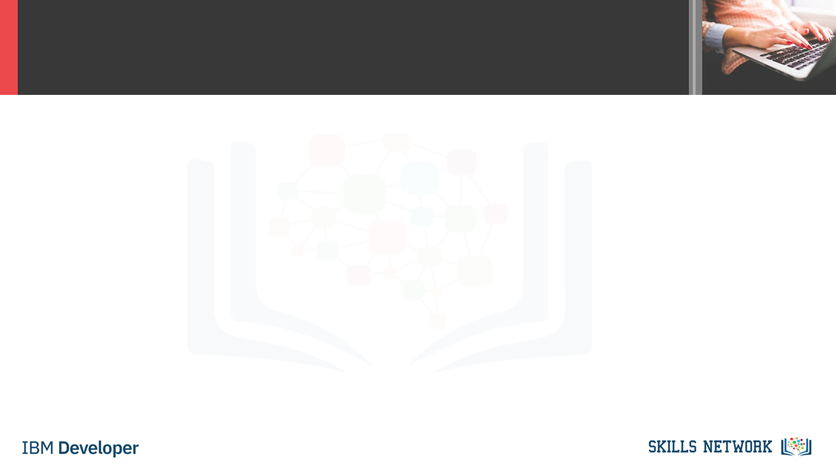
EXECUTIVE SUMMARY
With the emerging of new technology, IT professionals must keep learning new knowledge and new skills.
Top trends of technology in near future.
JavaScript, HTML/CSS, and Python are the top programming languages. SQL stays the top query language.
PostgreSQL and MangoDB will become the top 2 databases in near future.
Docker platform and React.js web frame keep growing their popularity in IT industry.
IT profession is still man-dominated. It’s not necessary to have an advanced degree to work in the industry.
Java, JavaScript, and Python are in high demand in the job market. And the average salaries of those languages are above $100k.

Slide 4
INTRODUCTION
The demand of IT profession grows fast whereas new technology and skills emerge. To keep competitive in the market, we need to understand the trends of future technology and skills in demand.
This analysis is to help readers or IT profession to understand the trends in technology and skills by identifying the trends of popular programing languages, databases, and IDEs.
In addition, the analysis also studied the demand and supply of skills through job postings, webpages and surveys so job seeks can better prepare themselves.
GitHub job postings reflect the demand of skills
Surveys show what skills are available in the market now and the possible changes in near future.

Slide 5
METHODOLOGY
Collect data from various sources such as job postings, training portals, and surveys by using APIs and webscraping.
Explore datasets to understand the size, columns, content, data types, etc. by using Pandas.
Wrangle data to remove duplicates, find and import missing values, and to normalize data by using Pandas & NumPy.
Analyze the datasets to understand the distribution, outliners, correlation, etc by using Pandas & Matplotlab.
Use data visualization to show data distribution, relationships, composition, and comparison by using Matplotlab & Seaborn.
Create a dashboard to display key trends by using IBM Cognos Analytics.

Slide 6
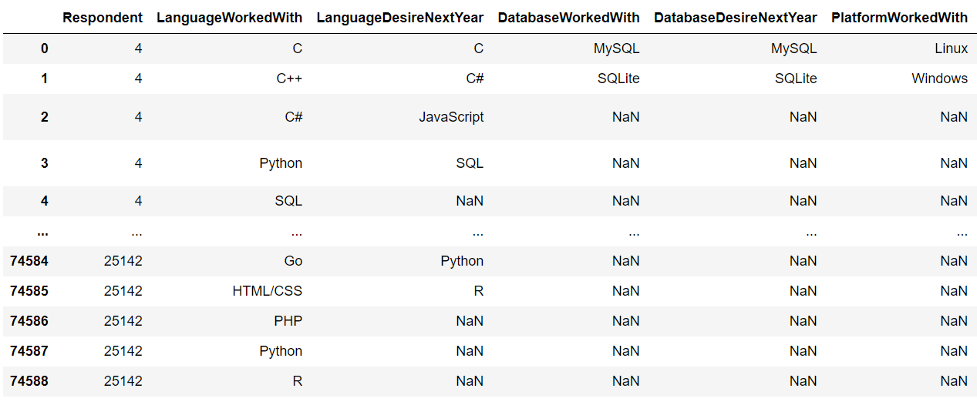
RESULTS

Slide 7
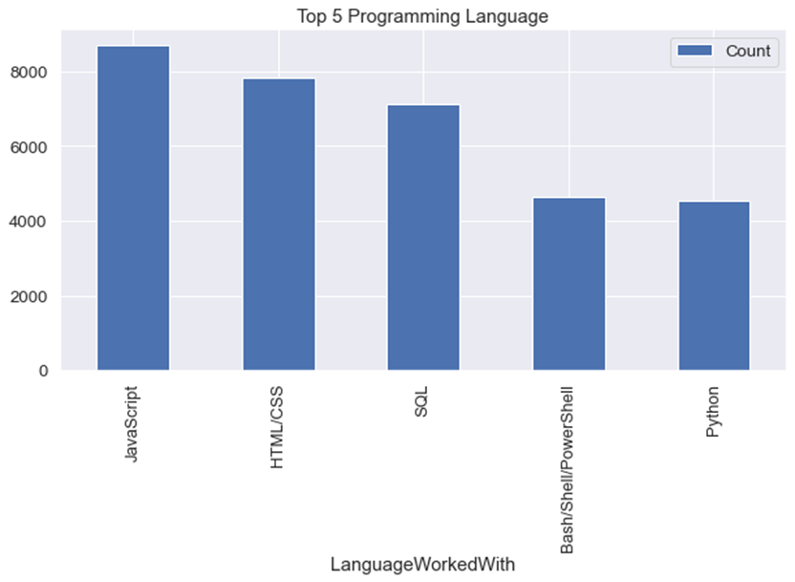
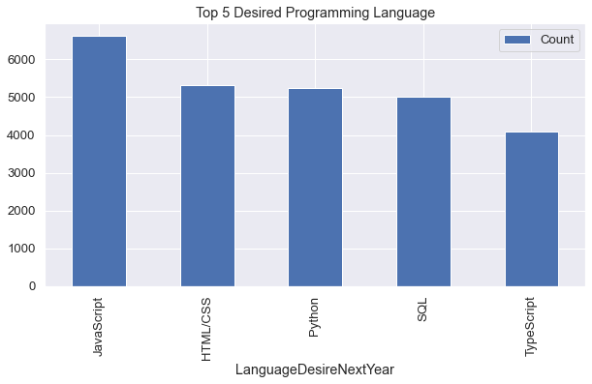
PROGRAMMING LANGUAGE TRENDS
Current Year
Next Year

Slide 8
PROGRAMMING LANGUAGE TRENDS
Findings and Implications
Findings
Implications
JavaScript is top trending language in the world
Python and TypeScript are becoming more and more popular
HTML/CSS and SQL still has great portion in language usage trend
Web developments and Web developers are still in high demands
JavaScript and TypeScript are crucial to learn for developers
Python is the new trending language, especially popular in AI fields

Slide 9
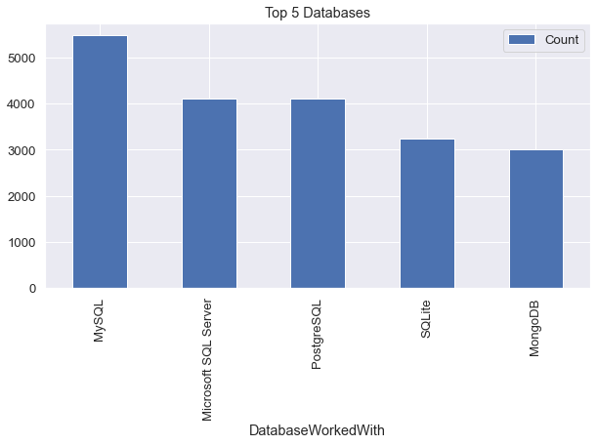
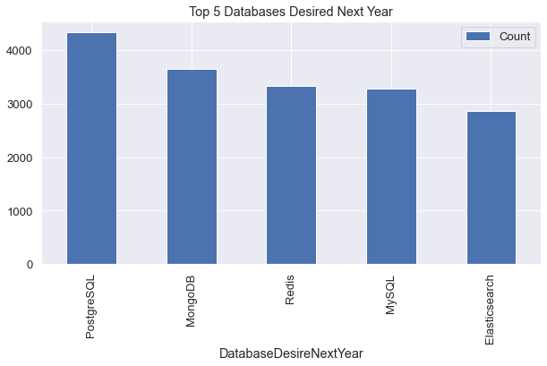
DATABASE TRENDS
Current Year
Next Year

Slide 10
DATABASE TRENDS
FINDINGS AND IMPLICATIONS
Findings
Implications
MySQL is the most popular database
There are still a lot of companies using Microsoft SQL Server
MongoDB and Redis are the most favorable NoSQL database
Open-source databases like MySQL are still preferable
Software development and Big Data technology still requires SQL
NoSQL databases will make an impact for relational databases

Slide 11
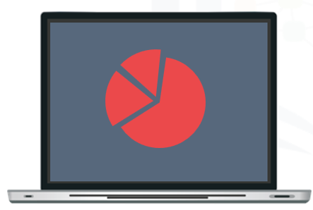

DASHBOARD
A dashboard with Cognos Dashboard Embedded (CDE)
The Permanent link of the read-only view of Cognos Dashboard
https://dataplatform.cloud.ibm.com/dashboards/decb3702-894a-4450-8d2e-af2d57faf479/view/6420a12e1098039753d1bde407912f027a30770be3bbd15586877b4908667297a96c13c2c8291e5adf130766f6ec1751cd

Slide 12
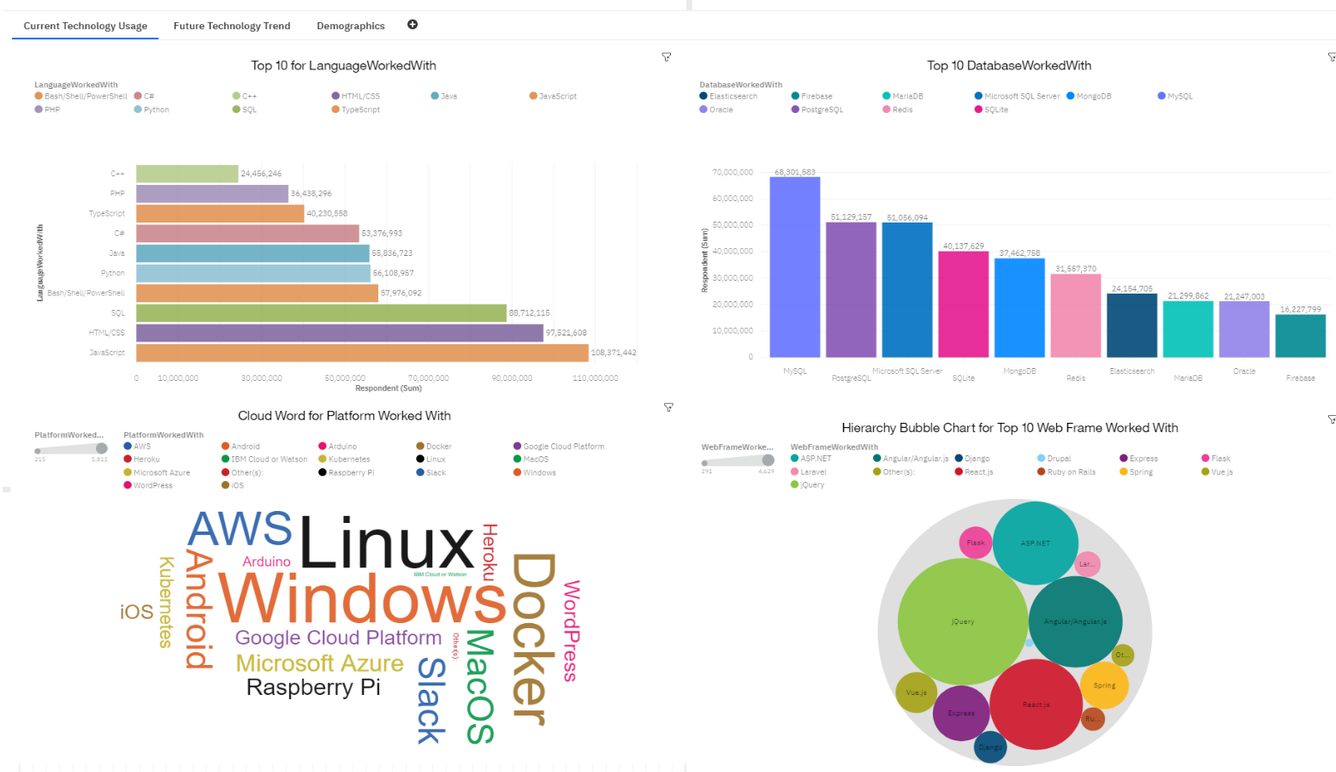
CURRENT TECHNOLOGY TREND

Slide 13
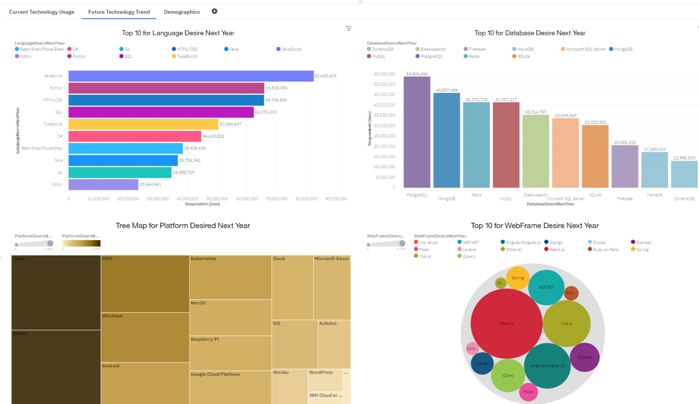
FUTURE TECHNOLOGY TREND

Slide 14
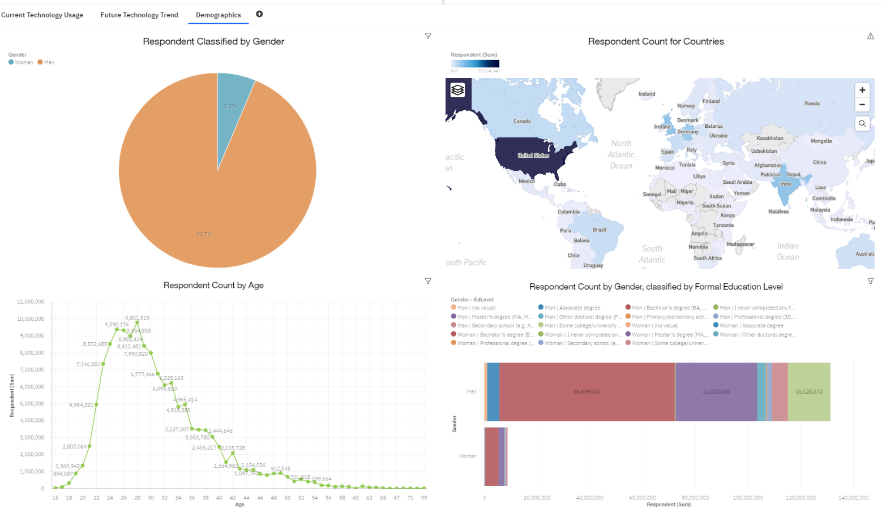
DEMOGRAPHICS

Slide 15
DISCUSSION
Technology Usage Trend Now and Future
Gender, Age and Education Discrimination in IT Industry

Slide 16
OVERALL FINDINGS & IMPLICATIONS
Findings
Implications
Technology trends changes every year
USA is the top technology country
There are extreme gender and age discrimination
Docker and AWS are the most popular platform
Programmers should always follow the latest technology trends
More countries should have the equal chance to be exposed to new technology
Gender and Age should not be one of the concerns or benefits of Employment

Slide 17
CONCLUSION
Technology Trends
Programming Languages, Database, Platform and Web frame Trends
Demographics Trends
Gender and Education
Programming Languages Trends and Salary Trends

Slide 18
APPENDIX
IBM Cognos Dashboard Embedded (CDE) is an AI-fueled business intelligence service that supports the entire data analytics cycle, from discovery to operationalization. It provides users with data discovery capabilities to visually explore and interact with their data to identify the key insights for improving data driven decisions. Users can perform data discovery and then quickly assemble that information into interactive, visually appealing dashboards, all without the need of formal training.

Slide 19
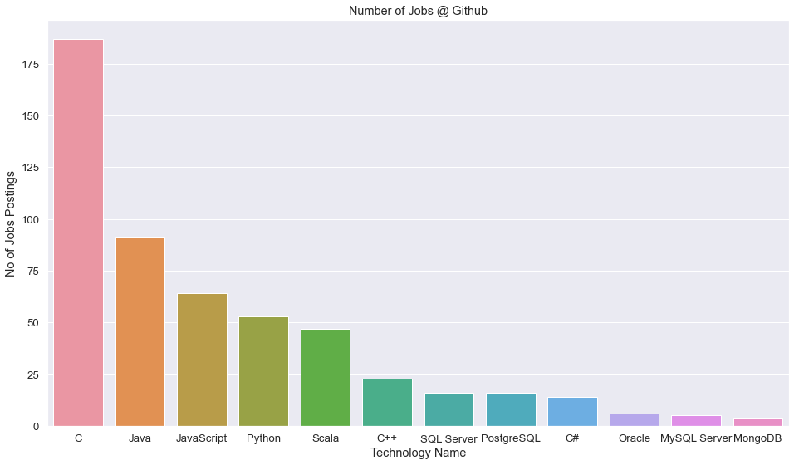
GITHUB JOB POSTINGS

Slide 20
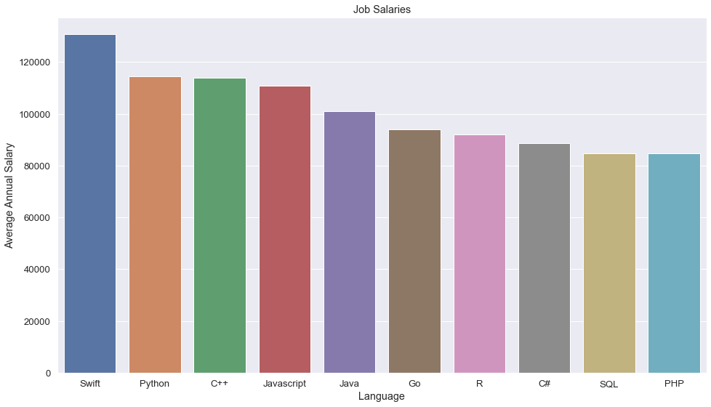
POPULAR LANGUAGES

Slide 21
Thank you
IBM Data Analyst Capstone Project
by
Kiam Boon Soh

